Slide 1
Databricks Workflows, Filter & Join Transformation, Aggregation
Submitted By
Maimoona Khilji

Slide 2
Content
Databricks Workflows
Include a Child notebook
Defining Notebook Parameters
Notebook Workflow
Databricks Job
Filter & Join Transformations
Filter Transformation
Different types of Join Transformation
Apply Transformation to F1 project
Aggregation
Simple aggregation
Grouped aggregation
Window Functions
Apply Aggregation to F1 project

Slide 3
Databricks Workflow

Slide 4
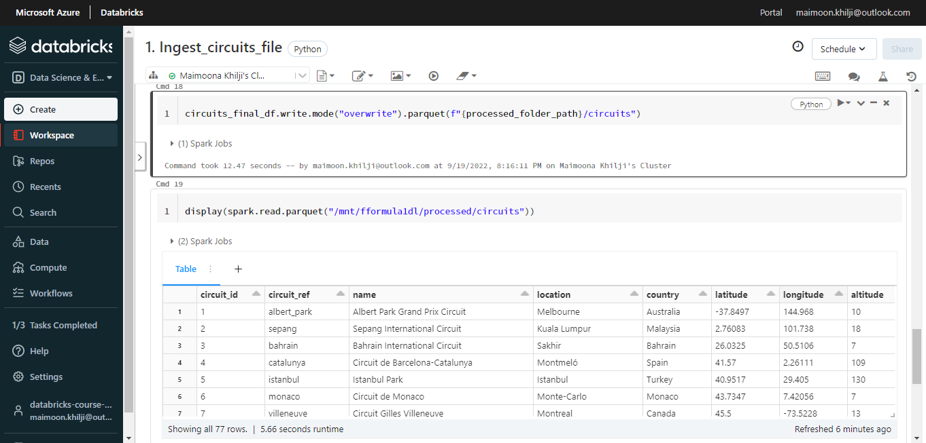
Include a Child notebook

Slide 5
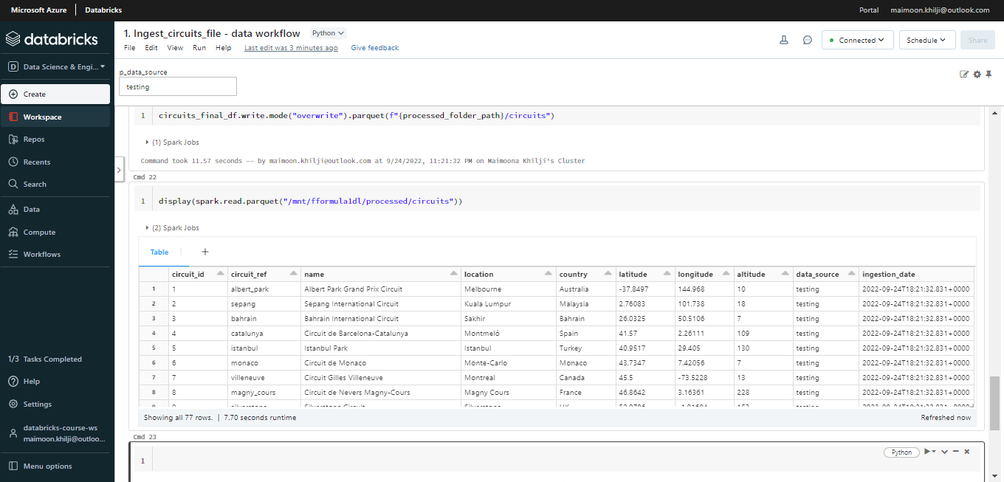
Defining Notebook Parameters

Slide 6
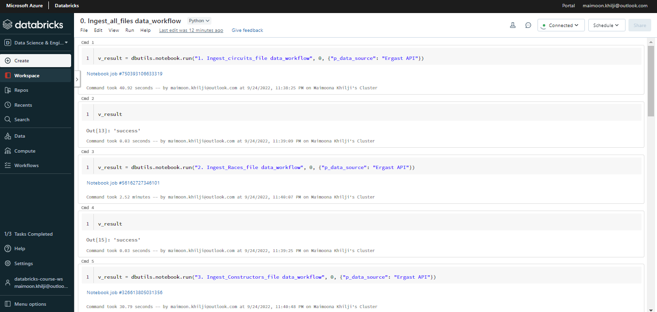
Notebook Workflow

Slide 7
Filter & Join Transformations

Slide 8
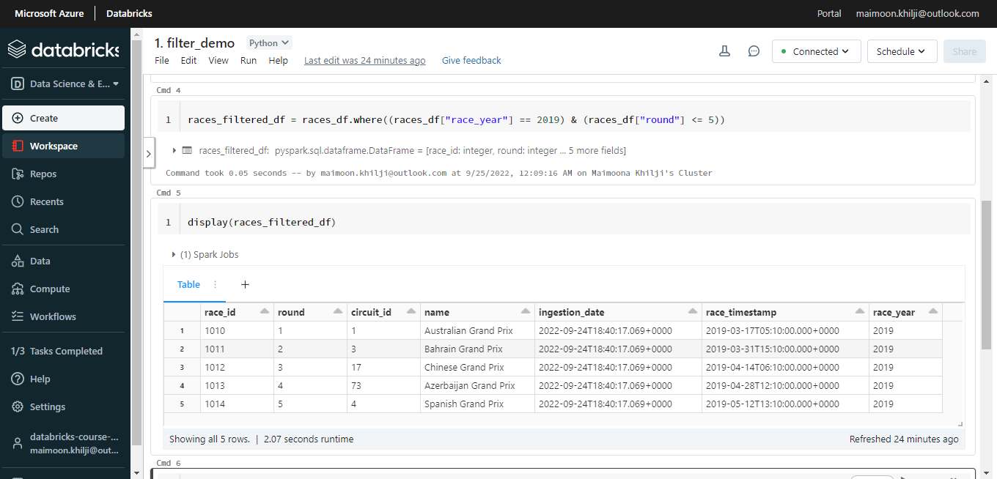
Filter Transformation
Notes:
It is similar to where in SQL.

Slide 9
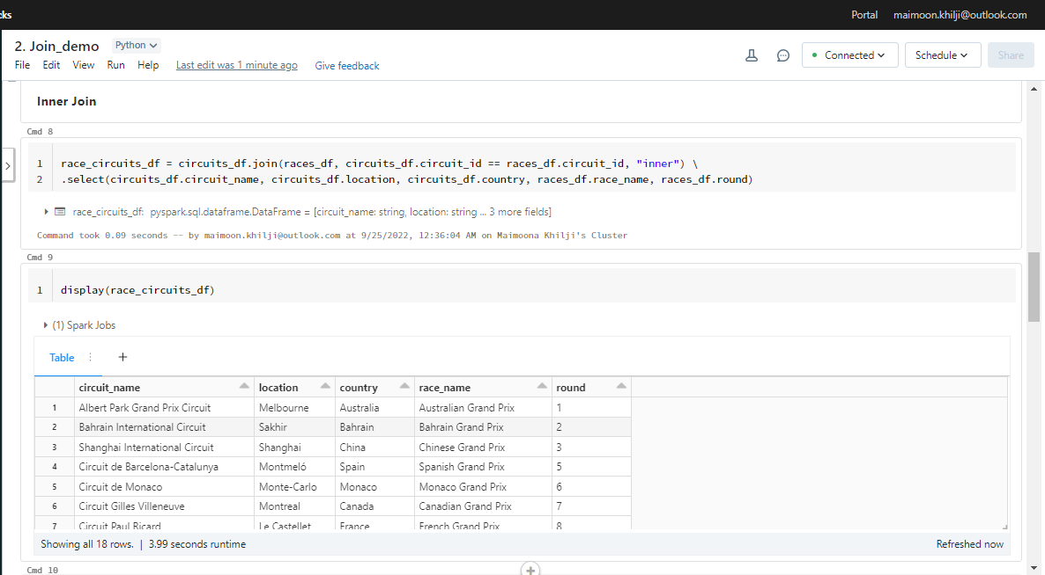
Join Transformation - Inner Join

Slide 10
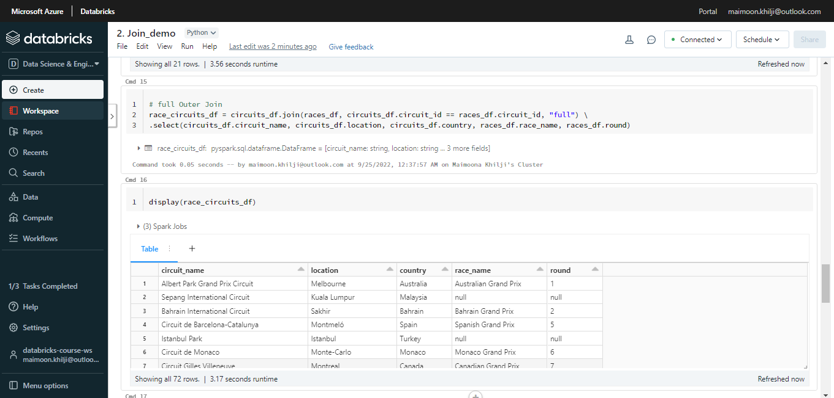
Join Transformation - Outer Join

Slide 11
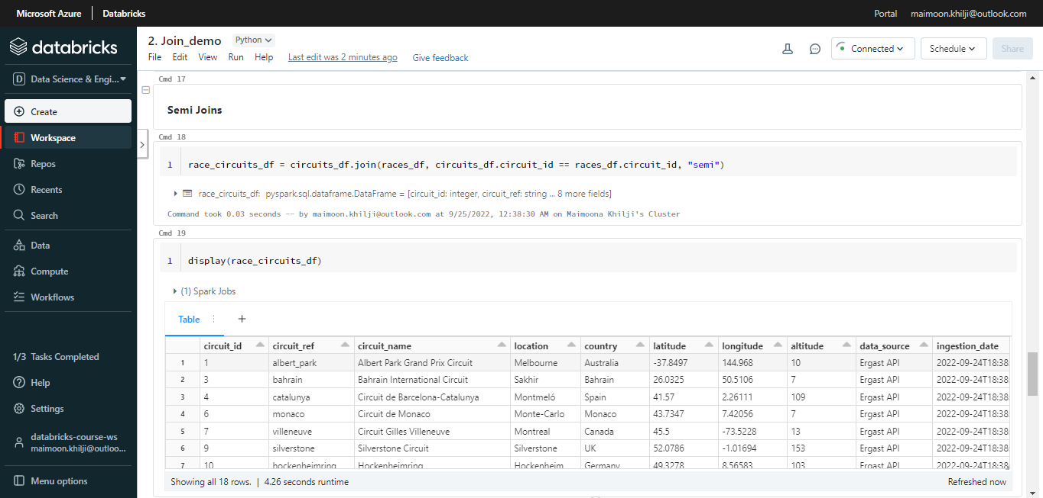
Join Transformation – Semi Join

Slide 12
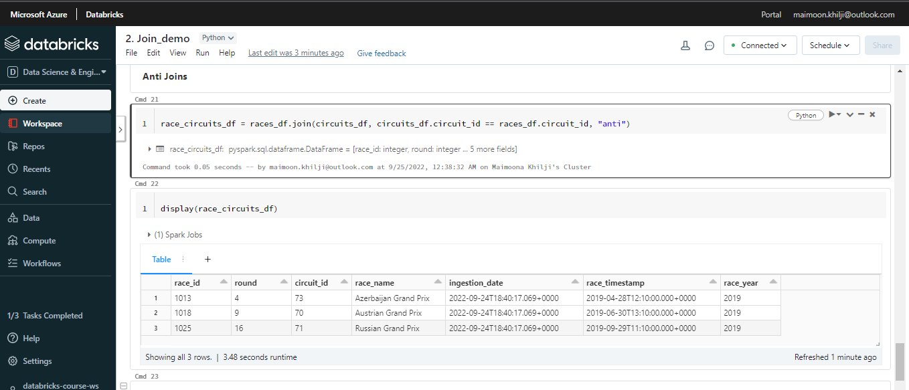
Join Transformation - Anti Joins

Slide 13
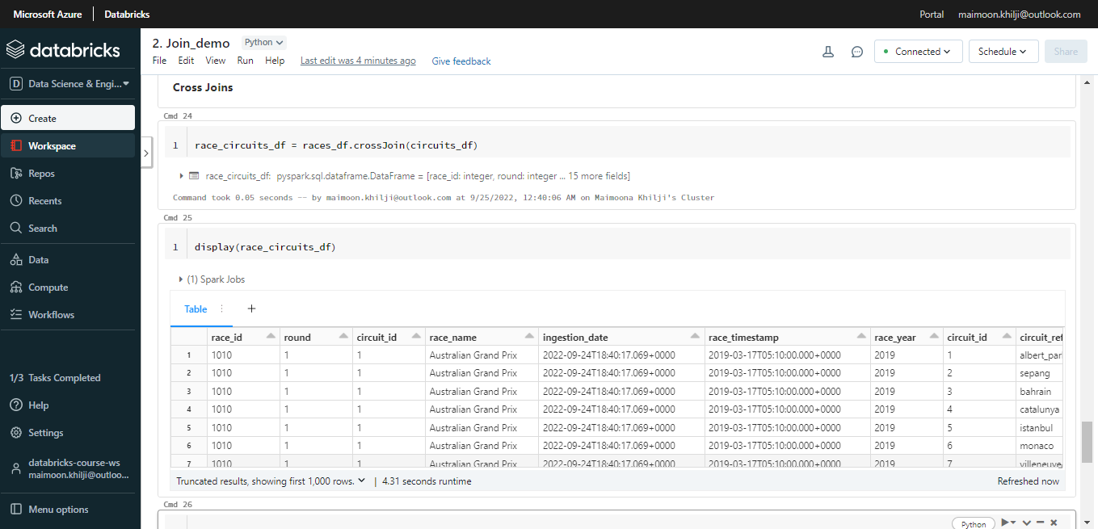
Join Transformation - Cross Joins

Slide 14
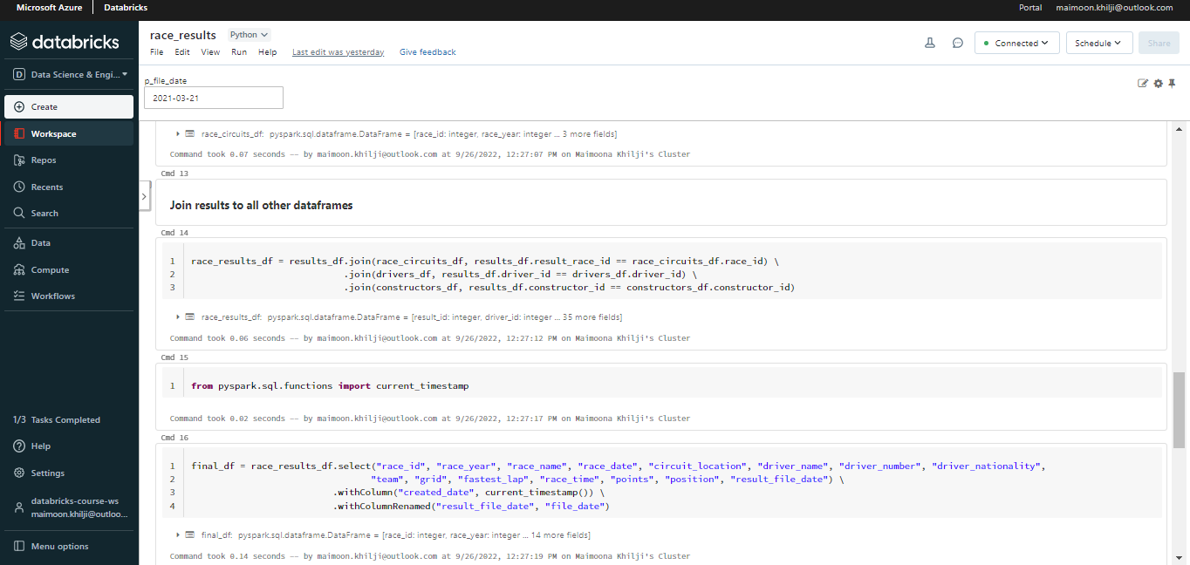
Join - Race Result

Slide 15
Aggregation

Slide 16
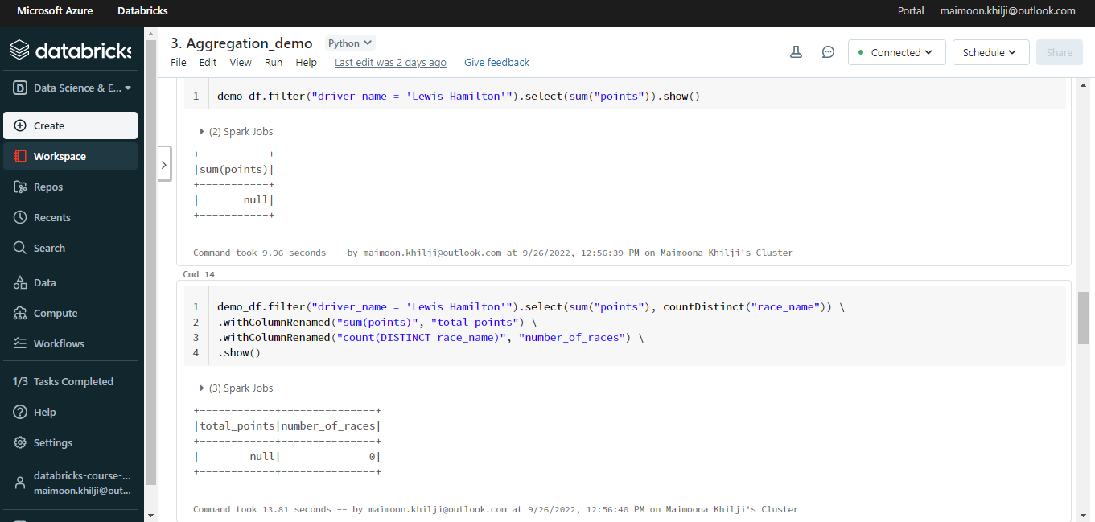
Simple Aggregate functions

Slide 17
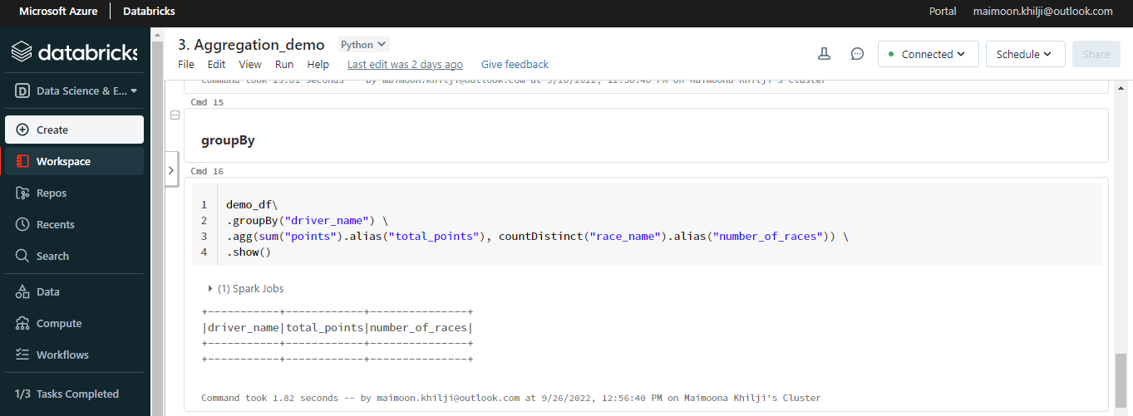
Group By

Slide 18
THE END

